Slide 1
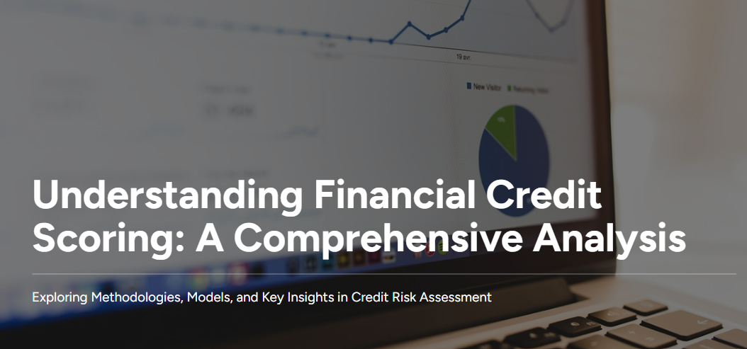
School of Computer Engineering KIIT - DU
Submitted by
Name:- AkashVerma Roll No.:- 2206006
Name:-Rohit Kumar Roll No.:- 2206045

Slide 2
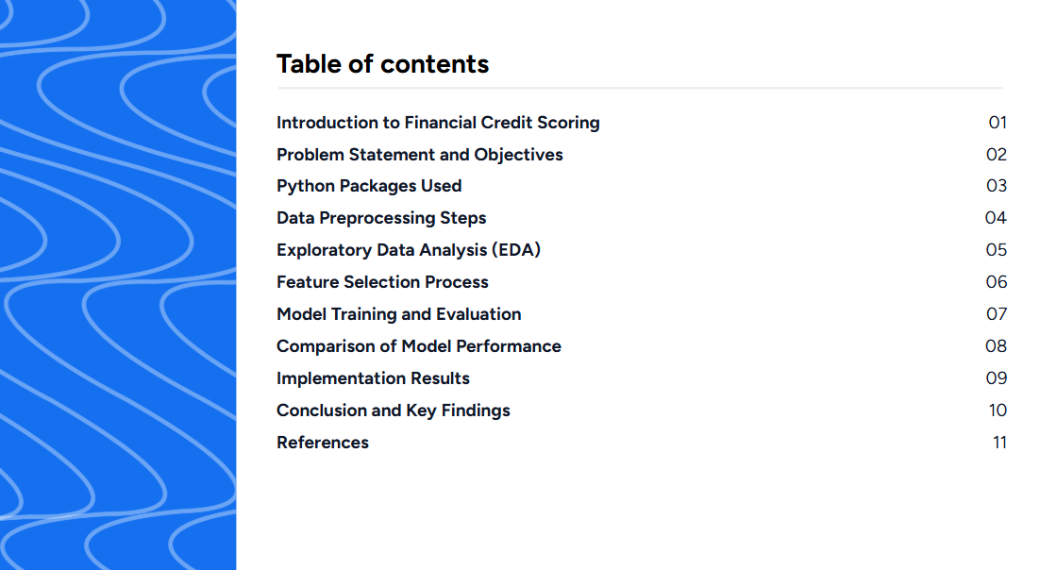
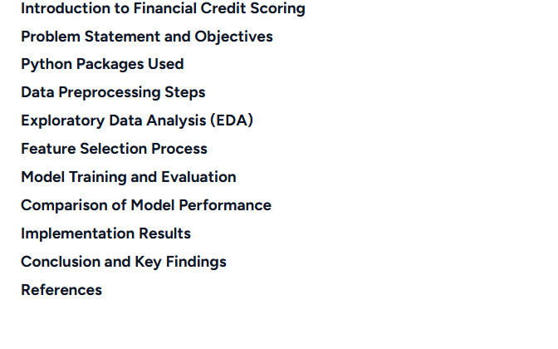

Slide 3
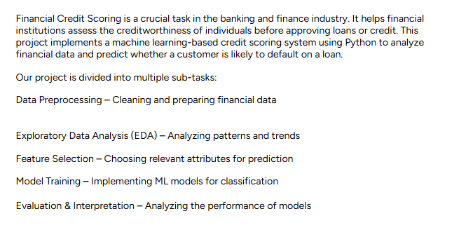

Slide 4
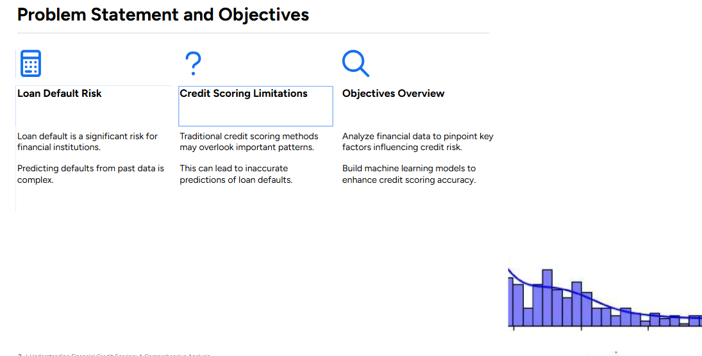

Slide 5
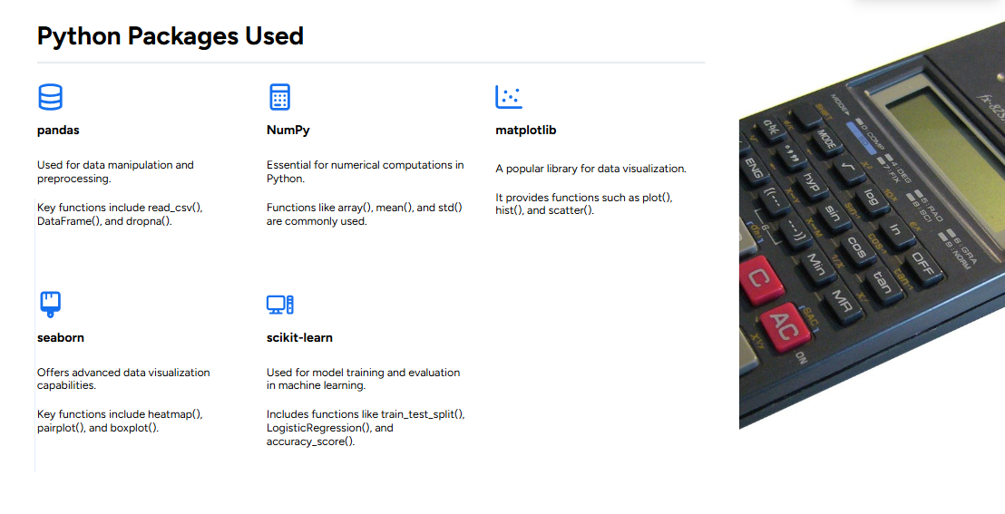

Slide 6
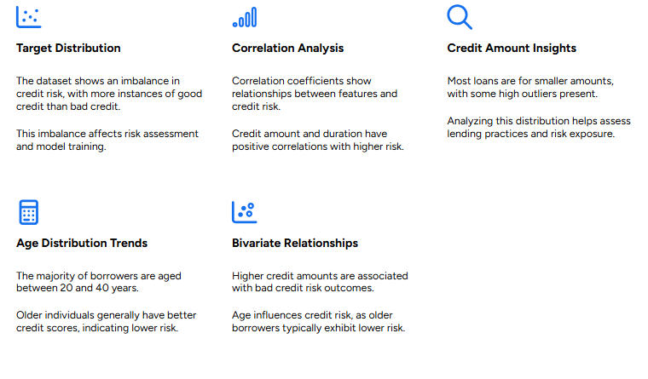

Slide 7
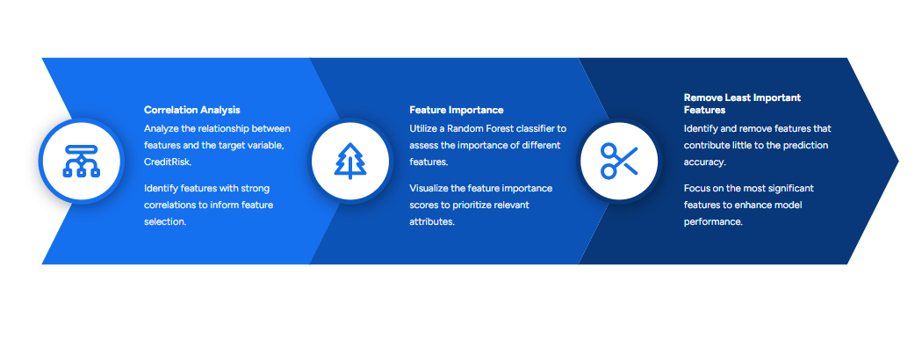

Slide 8
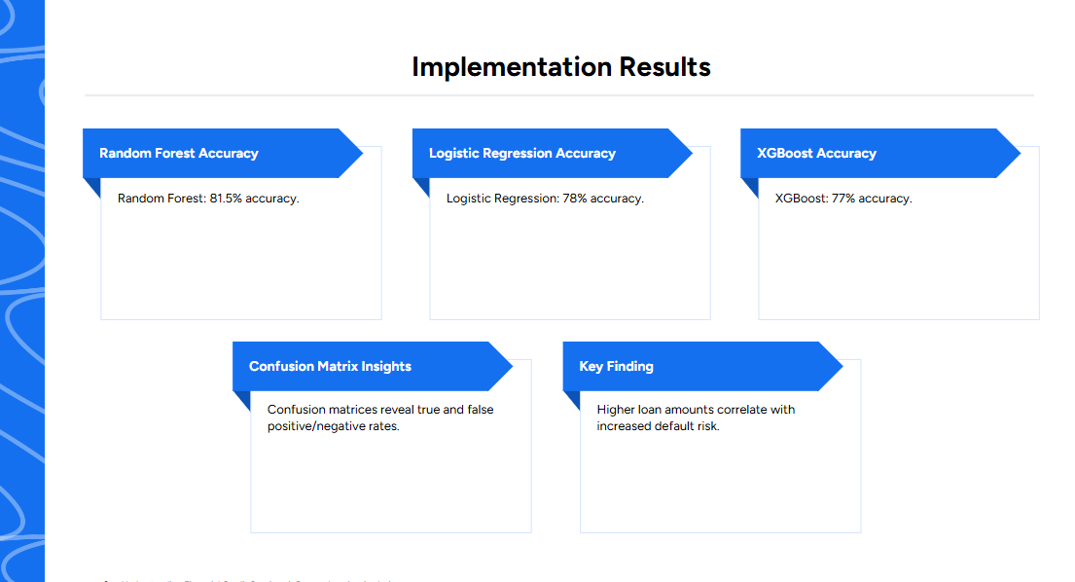

Slide 9

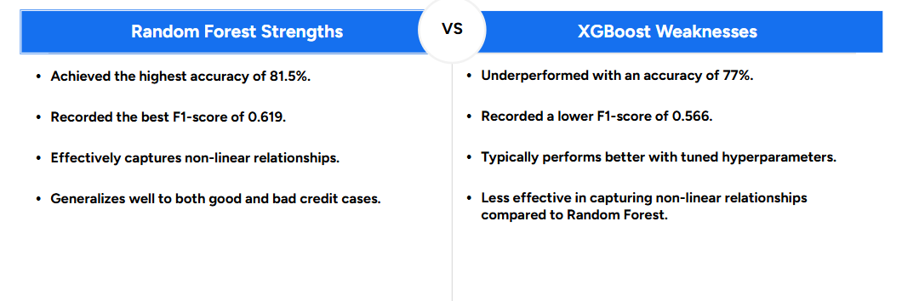
2. Confusion Matrix of Random Forest Model
Count IJ Actual
lecking Target Distribution
Correlation Analysis:

Slide 10
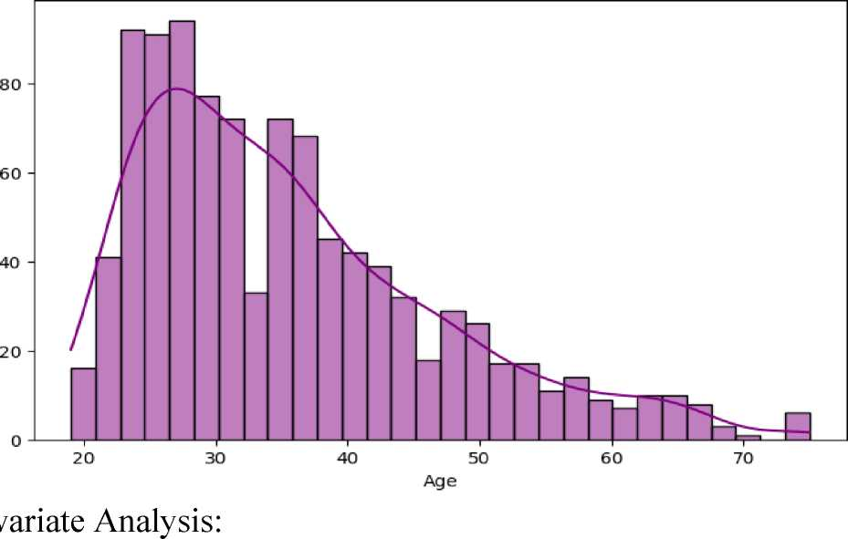
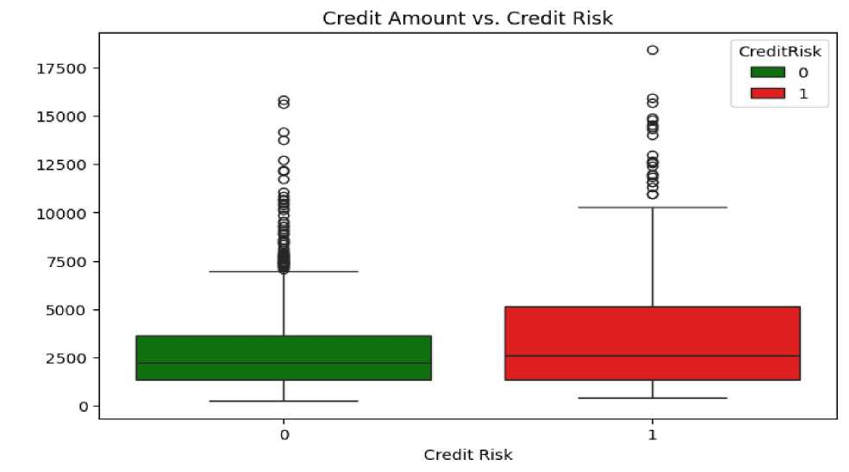
Age Distribution of Borrowers
1. Credit Amount vs. Credit Risk
2. Age vs. Credit Risk

Slide 11
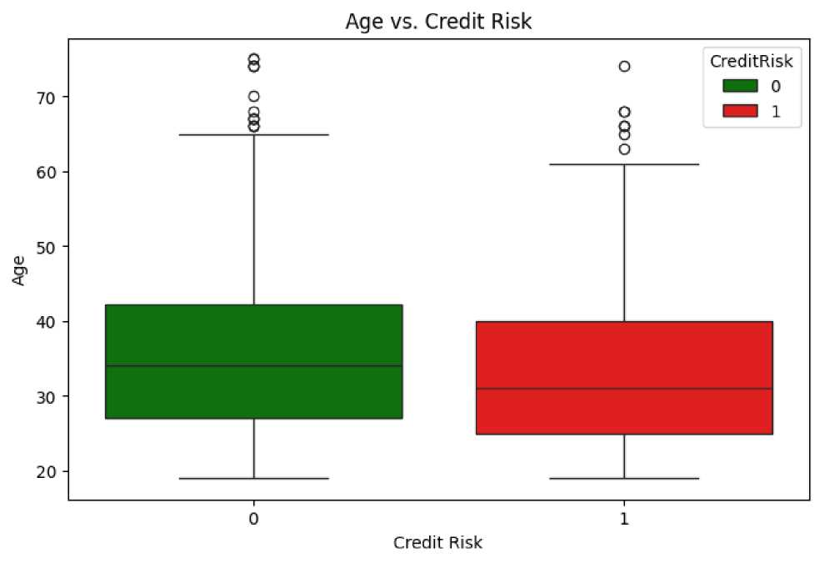
Feature Selection - Choosing relevant attributes for prediction: 1. Feature Correlation with CreditRisk

Slide 12
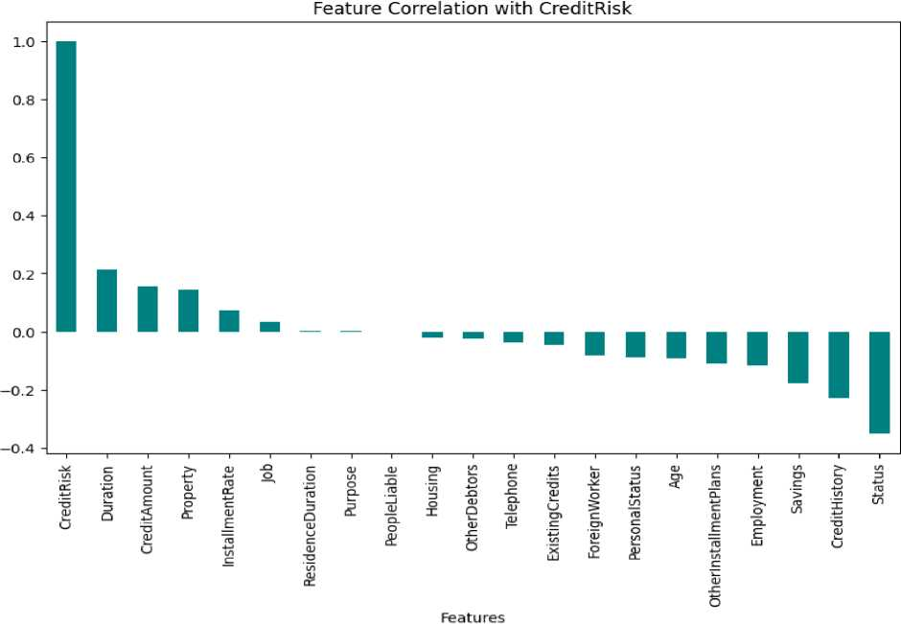
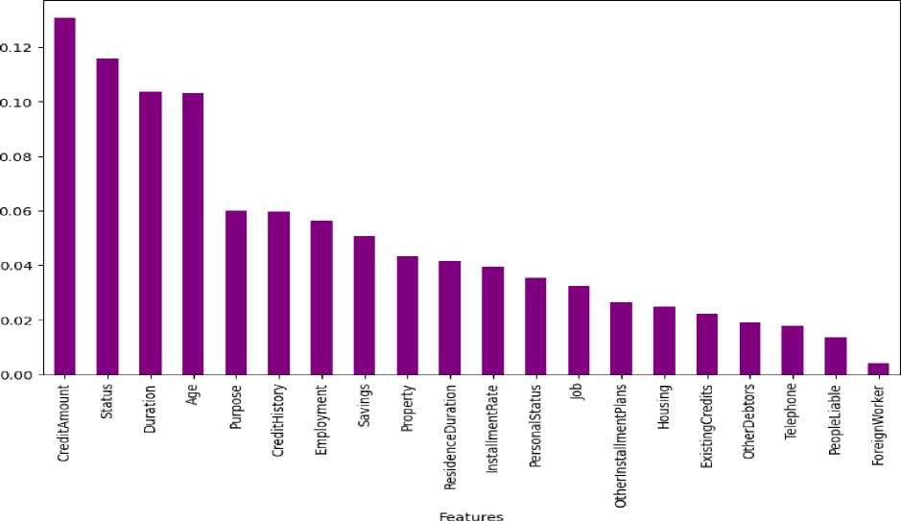
Importance Score Correlation
2. Feature Importance using Random Forest
Feature Importance using Random Forest

Slide 13
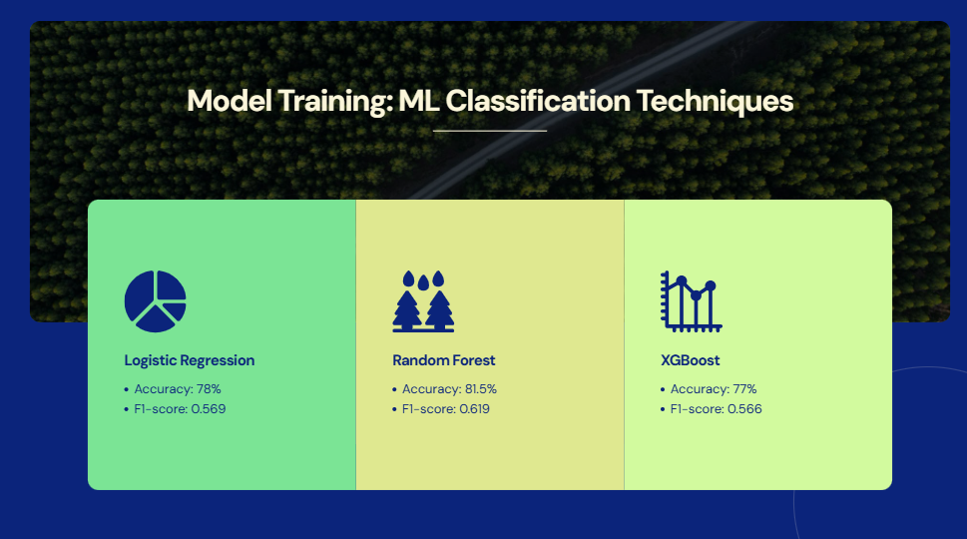

Slide 14
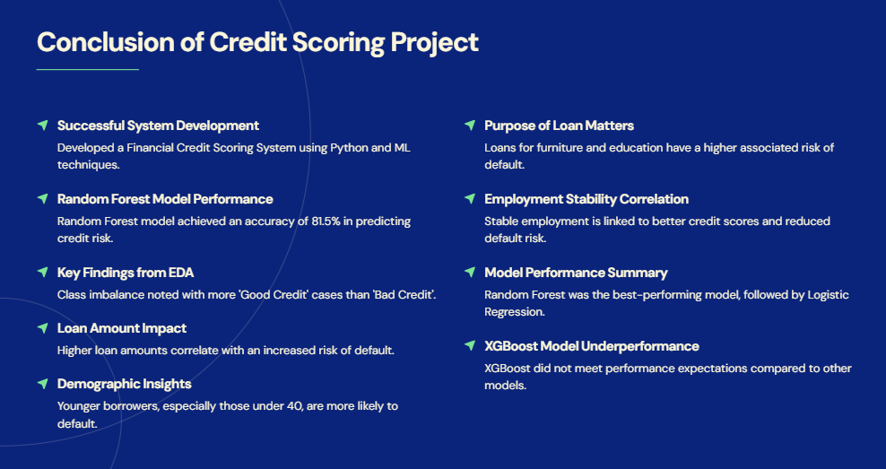

Slide 15
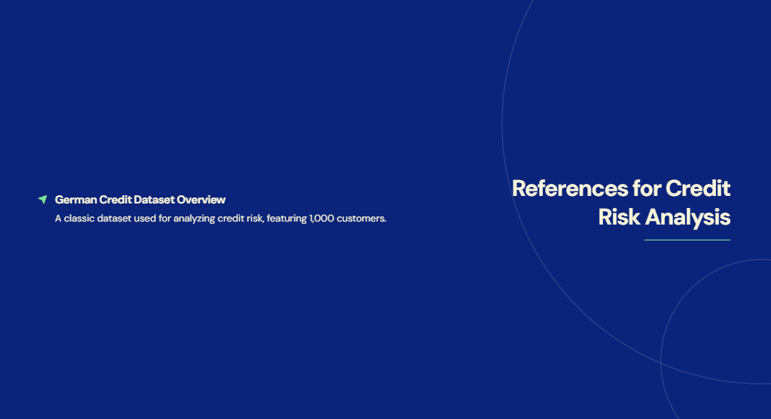

Slide 16


